Slide 1
Incorporating the healing phases into rehabilitation

Slide 2
Introduction
What are the three phases of tissue healing?
Do you think all tissue types heal the same way?
We have only discussed soft tissue healing briefly. Why is it called “soft” tissue?
What are the soft tissues in our bodies?

Slide 3
Soft Tissues
Skin
Ligaments
Muscles/
Tendons

Slide 4
Soft Tissue Healing Recap
Inflammatory phase
Fibroblastic repair phase
Maturation-remodeling phase

Slide 5
Rehabilitation Phases
Preoperative exercise phase
Prevent significant atrophy
Acute inflammatory phase
Pain, swelling, dysfunction
Fibroblastic repair phase
Loss of ROM & flexibility
Maturation-remodeling phase
Gaining full strength, power, coordination

Slide 6
Preoperative Exercise Phase
Not all rehabilitations!
Tears, ruptures, severe fractures
“Prehabilitation” sets up for a more positive healing process & potentially less damaging surgery
Stronger tissues, less strength losses, early return of neuromuscular control

Slide 7
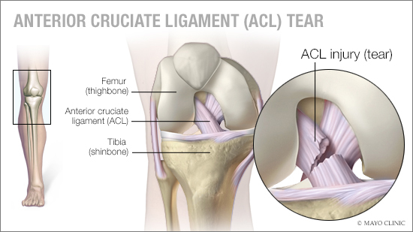
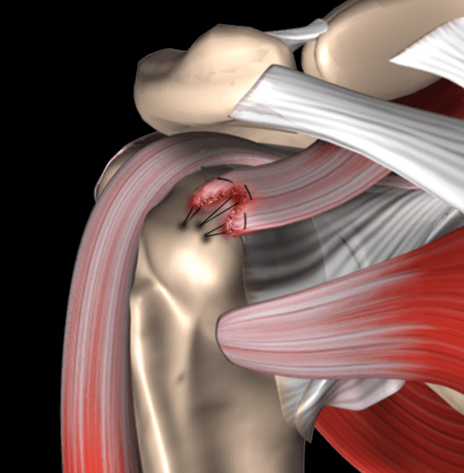
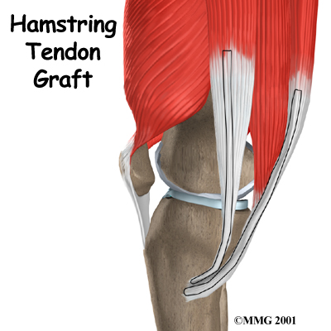

Slide 8
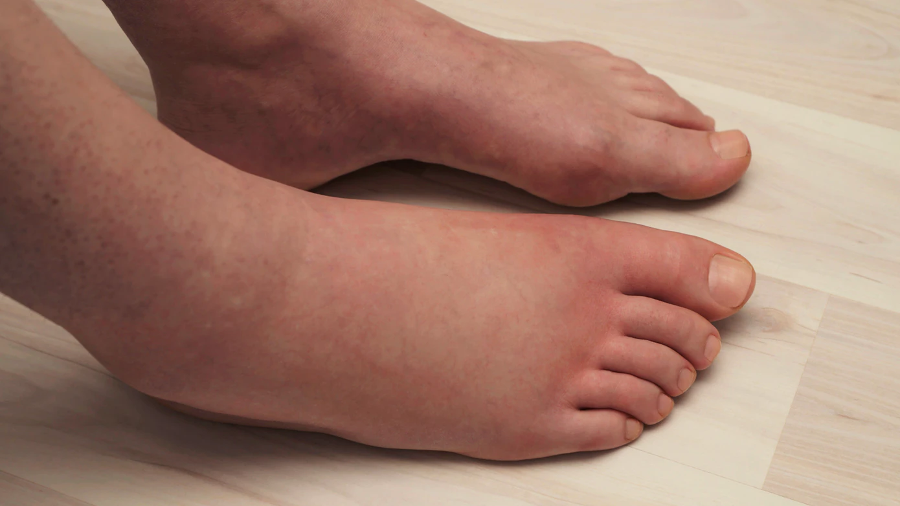
Acute Inflammatory Response Phase
How soon after the injury occurs?
Immediately!
What is the purpose of the inflammation & swelling?
Cleaning & damage control
Can swelling get out of hand? How?
Gravity
Trying to walk or limp too soon
Poor lifestyle habits
Not enough compression

Slide 9
During this Phase:
Control pain
Limit swelling
How?
Protection
Optimal Loading
Ice
Compression
Elevation
ACTIVE REST!
Use the parts of the body that aren’t injured to create exercises.

Slide 10
Think-Pair-Share
What are some total-body maintenance exercises that a patient with the following injuries can perform?
ACL sprain
Shoulder subluxation
Hip flexor strain
Forearm fracture
Grade II lateral ankle sprain

Slide 11
End of Inflammatory Phase
Typically inflammation is starting to subside around day five of the injury.
Days 1-2 the injured limb is mostly immobile, but isometric contractions can still prevent significant strength losses
Days 3-4, rehab should start to include pain-free AROM, & lower extremity injuries should be at least PWB
NEVER FORGET TO TREAT FOR PAIN!
The nerves & tissues are still repairing themselves

Slide 12
Fibroblastic Repair Phase
SCAR TISSUE will stick to itself!
Additional swelling should no longer occur, but the injury will still be painful!
*As soon as injuries stop causing swelling, move on
Full ROM, neuromuscular control, cardiorespiratory endurance, muscular strength & endurance

Slide 13
Think-pair-share
What are some ROM, PNF, & muscular strength & endurance exercises that a patient with the following injuries can perform?
ACL sprain
Shoulder subluxation
Hip flexor strain
Forearm fracture
Grade II lateral ankle sprain

Slide 14
Functional progressions!
How long does the fibroblastic repair phase last?
This will be a large majority of the rehab process!
Creativity is key ☺

Slide 15
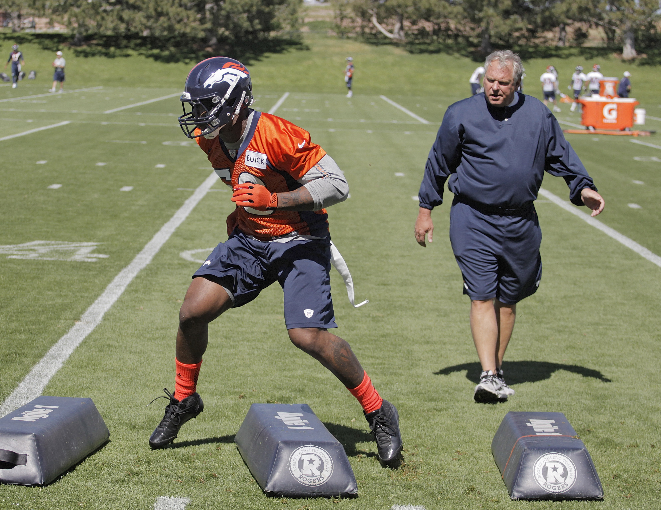
Maturation-Remodeling Phase
Full tissue/bone healing takes TIME.
Longest part of the rehab process!
By ideally 4-8 weeks post-injury, dynamic activity & sports specific exercises have been incorporated.
Now what is the ultimate goal of this phase?
RTP!

Slide 16
General red flags during Rehab
Increase in swelling
Loss of or lack of increase in ROM
Loss of or lack of increase in strength gains
Increase in laxity
Increase in symptoms

Slide 17
Closure
What are the NINE major components of a rehabilitation program?
How do they fit into the phases of rehab?

